Slide 1
DP Mixture
Machine Learning Course
Fall 2012
Tsinghua University

Slide 2
Goal
Group the given data set into several clusters
Automatically infer the number of clusters
Roughly have a sense of how nonparametric Bayesian models work

Slide 3
DP Mixture Model
Data:
Parameters (stochastic):
“membership” indicator:
component parameter:
Infer the posterior distribution of parameters
Inferred from data,
To ease inference, we adopt conjugate prior
likelihood, same as in
finite mixture models
as defined in CRP

Slide 4
DP Mixture Model (cont.)
For likelihood , we assume data in each component follows a Gaussian distribution, and all components share a common covariance matrix
, for now we fix and do not inference it.
For prior , we use the conjugate prior
, we can also fix for simplicity.
For prior , we use the CRP representation of DP, which yields the following local conditional distribution
: number of other people at table
this means we suppose that data was generated from isotropic Gaussians
the means of isotropic Gaussians also subject to a Gaussian distribution
current number of components
Kronecker delta

Slide 5
Inference by Gibbs sampling
Randomly initialize
Sample each from
old component ( ):
new component:

Slide 6
Inference by Gibbs sampling (cont.)
Sample each from

Slide 7
Optional: Collapsed Gibbs sampling
Sample only in collapsed space , with integrated out
old component:
new component:
same old tricks with Gaussian-like functions
You can find this term on previous slides

Slide 8
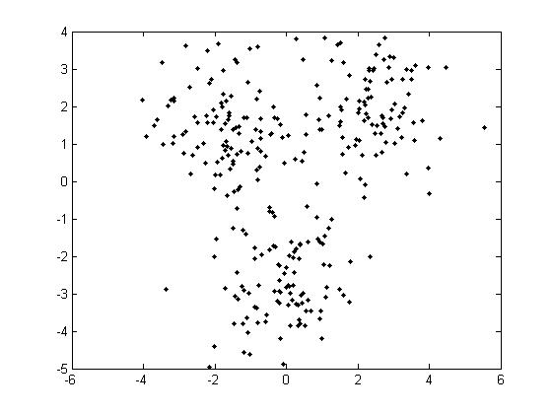
Generate Data
We recommend that you use Matlab to generate the data in two and three dimensions for the ease of visualization.
At least three different settings should be reported, e.g., with different numbers of mixture components, with zero mean or non-zero mean Guassian likelihood models to generate the data.
Suppose the data was generated from the mixture of 3 isotropic Gaussians. A naïve way to do this in Matlab is:
%Generating data
dat1=normrnd(0,1,100,2);
dat1(:,1)=dat1(:,1)+2.4;
dat1(:,2)=dat1(:,2)+2;
dat2=normrnd(0,1,100,2);
dat2(:,1)=dat2(:,1)-1.8;
dat2(:,2)=dat2(:,2)+1.4;
dat3=normrnd(0,1,100,2);
dat3(:,1)=dat3(:,1)-0.2;
dat3(:,2)=dat3(:,2)-2.6;
Here we fix for simplicity.

Slide 9
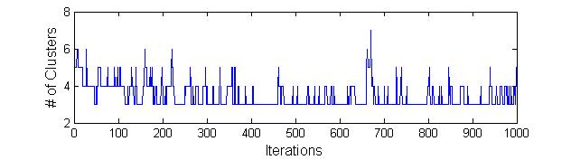
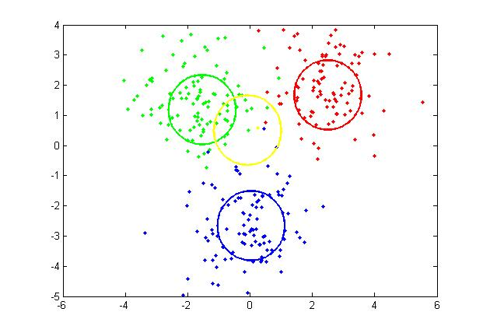
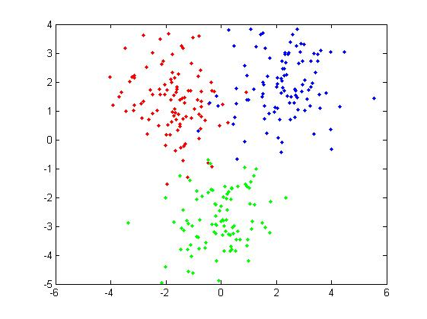
Learning
Then do Gibbs sampling as in P5-6 (and Collapsed Gibbs sampling as in P7(Optional)).
You can watch how the number of clusters vary through the process of learning. You can even plot a chart like this:
We can see how our data “decide” the number of clusters.
For Gibbs sampling, we inference z and φ.
For Collapsed Gibbs sampling, we only sample z.

Slide 10
How to evaluate
Posterior result should be a trade-off between the following 3:
difference between actual and expected number of clusters a priori:
Mahalanobis distance of all component means to their means a priori:
Mahalanobis distance of all data points to their centers:
Actually we shall take expectation of the 3 estimators, but in Gibbs sampling, we approximate this by taking sample average

Slide 11
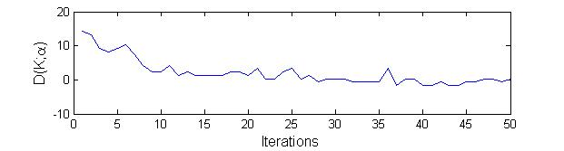
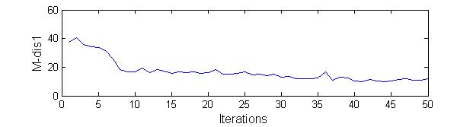
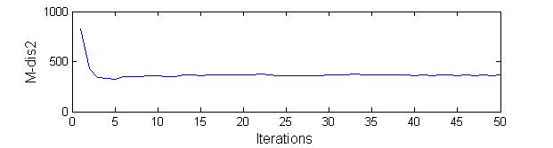
How to evaluate (cont.)
We want you to report
curve of the 3 estimators during the whole Gibbs sampling process
expected estimators (sample average) after mixing (take )
M-dis1=
M-dis2=

Slide 12
Submission
Implementation
Submit the code implementation before ?
Report 3 values in P10.
Submit as .tar file, including:
1 ) Source Code with necessary comments, including
Data generating
DPM training, testing and evaluation
2) ReadMe explaining
How to generate data.
Explain main functions, e.g., how to sample z and φ.
How to run your code, from data preprocessing to training/testing/evaluation, step by step.
what’s the 3 values in P10
If you do the Collapsed Gibbs sampling, write the derivation step by step in a file.
If you do the Collapsed Gibbs sampling, compare the per-iteration time cost with Gibbs sampling and try to explain if it is always necessary to use the collapsed inference strategy and why.

Slide 13
Reference
[1]Neal, R. M. (2000). Markov chain sampling methods for Dirichlet process mixture models. Journal of Computational and Graphical Statistics, 9:249–265.
[2]MacEachern, S. N. (1994). Estimating Normal Means With a Conjugate Style Dirichlet Process Procedure. Communications in Statistics: Simulation and Computation, 23, 727-741.

Slide 14
Thank You!

